Slide 1
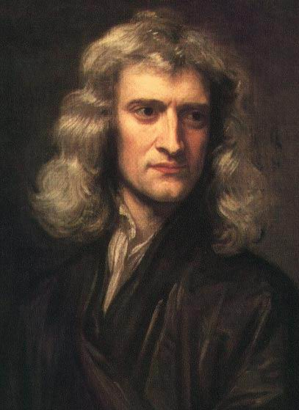
UNIT TWO: FORCES
Sir Isaac Newton 1642 – 1726
Introduction to Forces
This lesson will introduce you to forces.
This unit is the study of dynamics, another topic of mechanics.

Slide 2
Learning Goals
By the end of this lesson, you will be able to:
define force
identify and explain the four fundamental forces
identify and explain common forces
Draw Free-Body Diagrams, FBD’s

Slide 3
Success Criteria
Can I:
explain what is meant by the word “Force”
identify and explain the four fundamental forces in nature and be able to tell when each one is applied
accurately draw a FBD to show the forces acting on an object

Slide 4
Definition of a force
A force is defined as a push or a pull on an object.
Force is a vector quantity
The symbol for force is
Force is measured in Newtons, N
1 N = 1 kg∙m/s²

Slide 5
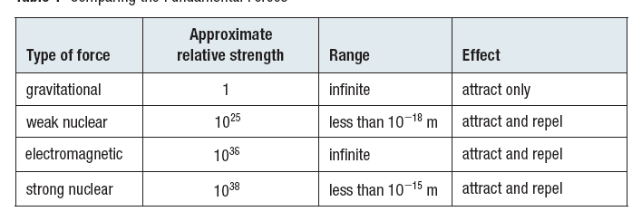
Fundamental Forces of Nature
There are four fundamental forces in nature
Gravity
Weak
Electromagnetic
Strong

Slide 6
Common Forces
Although there are four fundamental forces, there are
many forces encounter in our everyday lives
Gravity
Friction
Applied forces (pushes or pulls)
Normal force
Tension
Each of these common forces can be categorized as
one of the fundamental, but most common forces are
EM

Slide 7
GRAVITY
force between objects that have mass
always attractive
caused by the warping of space-time
equation derived by Newton
affects anything with mass, atoms to galaxies
FRICTION
is an electromagnetic force
usually opposes motion
caused by microscopic welds, (similar to velcro)
depends on the force pushing objects together
and the roughness of the objects

Slide 8
APPLIED FORCES
is an electromagnetic force
usually pushes or pulls
can act in the dir of motion or opposite to the dir
of motion
can be caused engines and motors
NORMAL FORCE
is an electromagnetic force
is created when objects push on surfaces
doesn’t always, but sometimes can equal gravity
in magnitude
always acts perp to the surface

Slide 9
TENSION
is an electromagnetic force
pushes or pulls within strings and ropes
can act in the dir of motion or opposite to the dir
of motion

Slide 10
PRACTICE Problem
1. Which of the following is not a fundamental force?
Weak
Normal
Strong
Gravity
Electromagnetic

Slide 11
PRACTICE Problem
2. Which of the following forces are infinite in range?
Weak and strong
Normal and strong
Strong and gravity
Gravity and electromagnetic
Electromagnetic and weak

Slide 12
PRACTICE Problem
3. Which of the following is equivalent to a Newton?
1 kg m²/s²
1 kg m/s
1 kg m/s²
1 kg m²/s
1 kg m²/s

Slide 13
Free-Body Diagrams
A FBD is a diagram that shows ALL forces acting ON an object.
FBD’s
only show forces acting on the object
assume all forces act at the center of the object
are useful in determining the net force on the object

Slide 14
Sample Problem
A car of mass 1200 kg has an engine that applies 2000 N [F] of force. Friction amounts to 1350 N. Draw a FBD and determine the net force acting on the car.
Sol’n:
F_{N}
m = 1200 kg
F_{a} = 2000 N [F]
F_{f} = 1350 N [B]
F_{net} = ?
1200 kg
F_{f}
F_{a}
F_{g}

Slide 15
F_{N} and F_{g} cancel out since the car doesn’t move
vertically. So the net force is in the horiz dir.
∴ the net force is 650 N [F]

Slide 16
PRACTICE Problem
4. Which of the following is true about a FBD?
a. only show forces acting on the object
b. assume all forces act at the center of the object
c. are useful in determining the net force on the object
All of the above
a. and b. only

Slide 17
PRACTICE Problem
5. Common forces are mostly forms of which fundamental force?
gravity
normal
weak
electromagnetic
strong

Slide 18
PRACTICE Problem
6. A rocket of mass 1.2 kg has an engine that applies 200. N [U] of force. Gravity amounts to 120 N [D]. Air resistance amounts to 15 N [D]. Determine the net force acting on the rocket.

Slide 19
HOMEWORK
Read Section 3.1
Review Tutorial 1 and 2
Questions 1 – 2 pg 119
1 – 3 pg 120
2, 5, and 15 pg 122

